Slide 1
Autonomous Vehicle and Quantum Internet
Chunming Qiao, Ph.D.
SUNY Distinguished Professor, IEEE Fellow
Computer Science and Engineering
University at Buffalo, SUNY
qiao@buffalo.edu

Slide 2
Current Facilities and R&D Projects
UB Center for Connected and Autonomous Mobility Platforms and Systems (CAMPS) - New
Connected and Autonomous Vehicle Applications and Systems
(CAVAS) since 2010

Slide 3
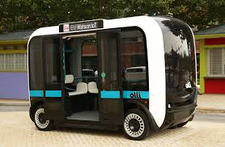
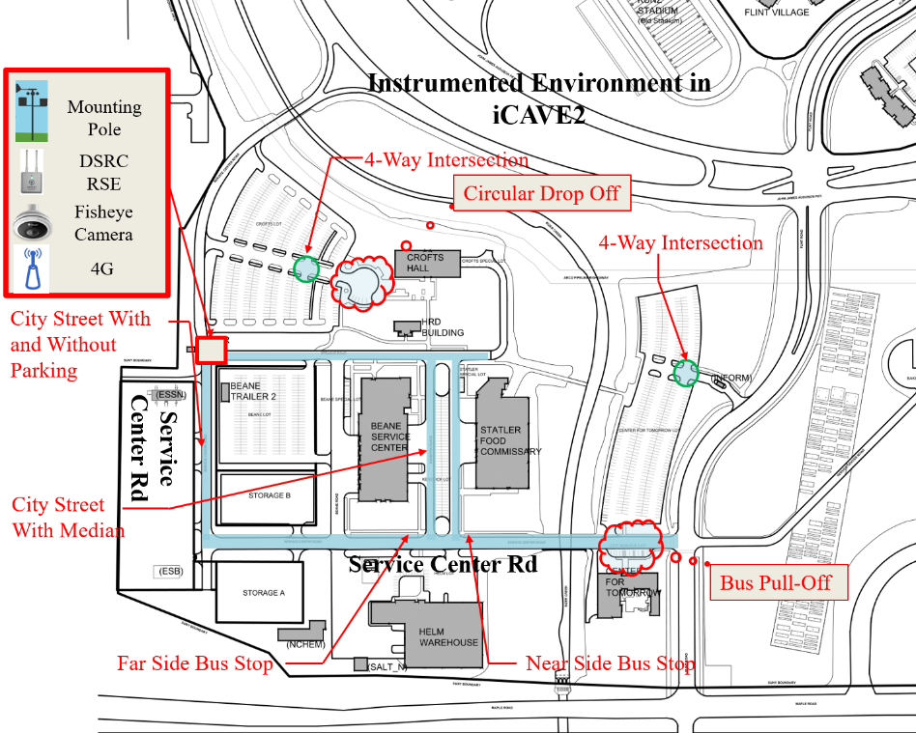
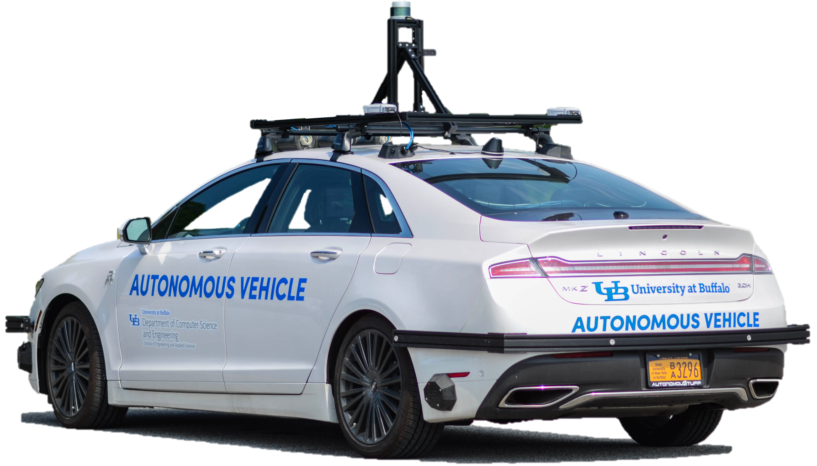
Unique Facilities: Connected Autonomous Vehicles (CAVs) and Proving Grounds
Above: Level-4 SDS “Olli” (for testing)
Below: Lincoln MKZ (for development)
On-campus Proving Grounds (Near Maple and Flint Rd)

Slide 4
R&D and Experimental Projects
(click to play a collection of Youtube videos)
Lots of CV, AI/ML and even LLM (mother of all AI projects – Tim Cook)
Autonomous Driving Pipeline (Localization, Mapping, Perception, Planning/Control)
Open-source (latest ROS2-based Autoware.Core/Universe)
Digital Twins and VR/AR Simulations (e.g., Carla)
Applications of AI/ML, including LLMs, to Synthesis Testing Environments
Vehicle-to-X (V2X) Communications (where X includes e.g., road-side units)
Integration of Vehicle and Infrastructure for Cooperative Sensing and Control
Security (e.g., Adversarial Attacks and Defense) related to ML models for sensors
Many more…

Slide 5
Quantum Internet
Basics
Entanglement
Distributed Quantum Comuting

Slide 6
Quantum Entanglement
Light is both a wave and a particle (quantum)
  Polarizations (horizontal and vertical) represent quantum states
Superimposition
  A single photon’s state can also be 1/0 at the same time (each with 50% probability when measured)
No clone theorem
  Copying (or measuring) destroys the superimposed states.
  Is why Quantum Key Distribution (QKD) (and one-time padding) is the only proven secure encryption.

Slide 7



Quantum Entanglement (novels)

Slide 8
Quantum Entanglement
Generate a pair of ”entangled” photons or quantum bits or qubits
  called Bell pair or Einstein–Podolsky–Rosen or EPR) pair
  Their state is described as a wave function (superimposed 0/1)
Distributes them to Alice and Bob (to be described)
If Bob measures and gets 1, the qubit at Alice will be in 1
  instantly and no matter how far apart – collapses of the wave function (no longer entangled afterwards)
  spooky action at distance. – Einstein (initially thought that there was some local hidden variables)
  John Bell showed (via contradiction) that the local hidden variables don’t exist → implying quantum entanglement exists.

Slide 9
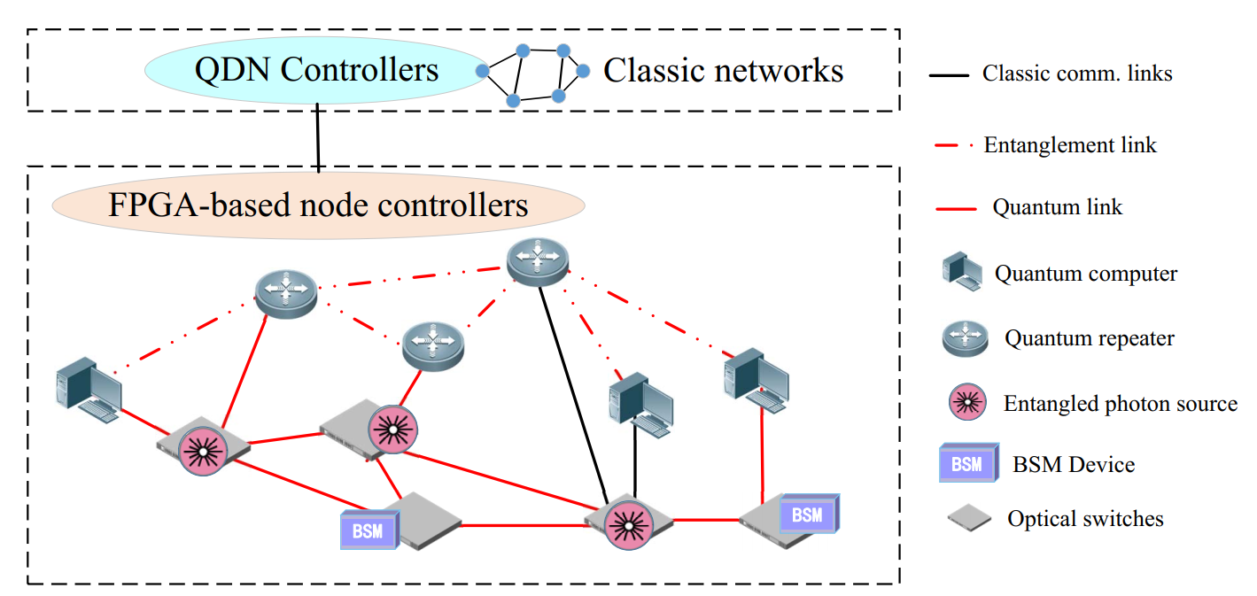
Quantum Data Networks (QDN)
Hybrid classical and quantum networks
  Classical network for control signals or measurement results
Notes:
EPS is optional, depending on underlying technologies,
Photon-atom interaction.

Slide 10
From Entanglement Routing To Teleportation
Routing: find a path from Alice to Bob via one or more repeaters
Entanglement link: generates/distributes a Bell pair (c-bits) over each hop
Each repeater performs a quantum swapping, eventually forming an Entanglement Connection
Teleportation of a data qubit
  Alice makes a joint measurement of its data qubit with its c-bit, sends results to Bob
  Bob performs a unitary operation with its own c-bit accordingly and recovers Alice’s data qubit
The EC gets “destroyed” afterward – one data qubit per EC

Slide 11
Main Challenges and Opportunities
Limited quantum memory for data qubits or entanglement purposes (c-bits)
  A repeater needs at least two c-bits at a time for each E2E entnanglement connection
Limited # of entangled photon sources (EPS) to generate the Bell pairs
  EPS are expensive (Capex and Opex)
Unreliable Bell pair generation
  Low success probability (e,g., about 2×10⁻⁴)
Error-prone Bell pair distribution
  Low energy of a single photon means likely transmission loss, which in turn means failed
Low fidelity (how close to the ideal state), fast de-coherence (decay), and other errors
Limited # of (good/usable) entanglement links and E2E connections, and ultimately a lower throughput
One should act fast while the entanglement lasts with e.g., asynchronous/distributed protocols and online processing

Slide 12
Earlier Approaches to Entanglement Routing
Greedy algorithm finds shortest paths (in hops)
One link failure along a path results in many wasted links
Q-CAST first finds most reliable paths
Then, try to establish as many “segments” as possible
  salvage as many connections as possible using the segments
  requires “link state” exchanges with other nodes within k hops

Slide 13
Redundant Entanglement Provisioning and Selection (REPS)
First, proactively try to create redundant links
  Subject to resource limitations, e.g., more links on (r₁, r₂) and (r₁, d₂) than in Q-CAST
  Centralized (and batched) processing: no prior commitment of redundant links to a specific SD pair
Then, intelligently stitch together successful links
  Red link on (r₂, r₃) can be used for the green SD pair
  More flexible and efficient

Slide 14
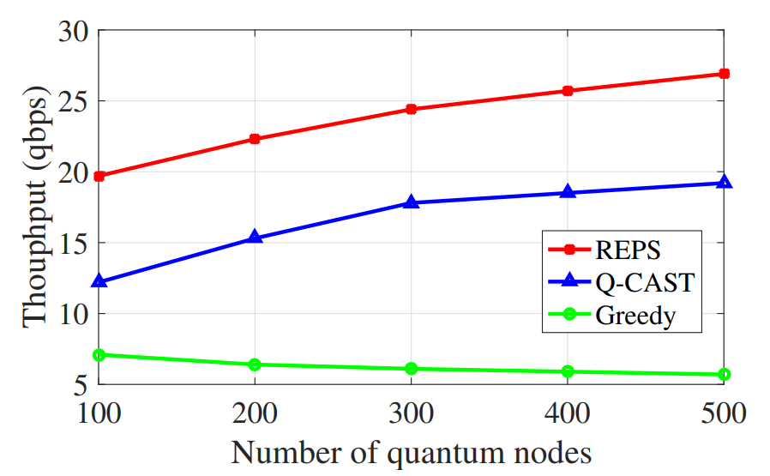
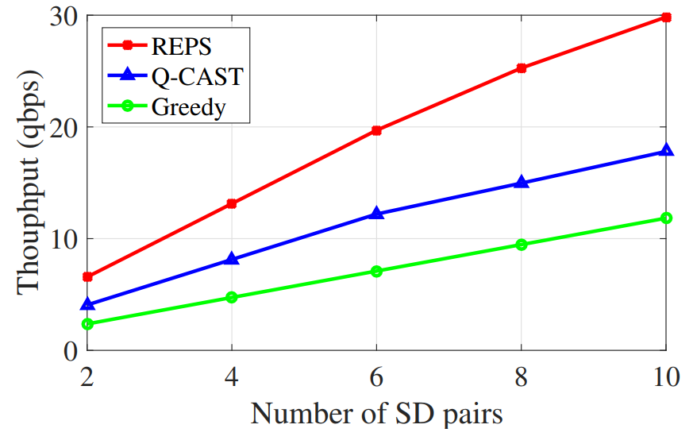
Throughput Performance of REPS
Measured in terms of one (data) qubit per E2E connection per time slot
REPS can significantly increase the network throughput
  More efficient use of resources before and after link failures
Notes:
50%

Slide 15
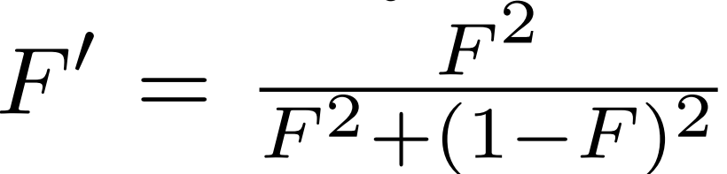
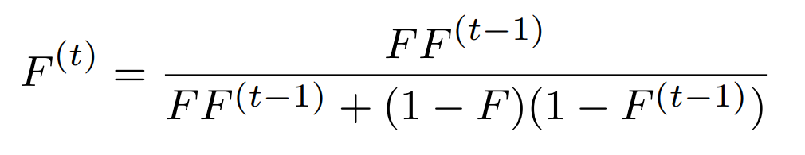
Ensuring E2E Fidelity with Intelligent Purification Schemes
Each link (Bell pair #1) may be purified with a sacrificial Bell pair (#2)
  If M₁=M₂, keep #1; otherwise, re-try; Link fidelity improved from F < 1 to F’
  (in general, from F⁽¹⁾ to F⁽²)
Use t > 2 Bell pairs for a higher link fidelity

Slide 16
E2E Fidelity aware Routing And Purification (EFiRAP)
Would like to have an E2E connection with a guaranteed (min) fidelity
Challenges
  E2E fidelity is hard to calculate
  Ensuring a minimum link fidelity for each and every link doesn’t mean much
  Purify a link may unintentionally decrease the E2E fidelity (assuming bit flip errors)
  Purify a link requires more precious resources (e.g., sacrificial Bell pairs and quantum memeory)
Solutions
  Joint optimization of routing and purification
  Purification scheme: which link(s) to purify and by how much
  More details in our Infocom 2022 Technical Program (Paper 1, Session F2).

Slide 17
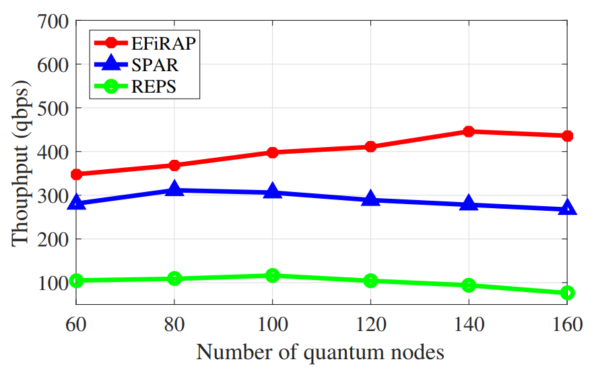
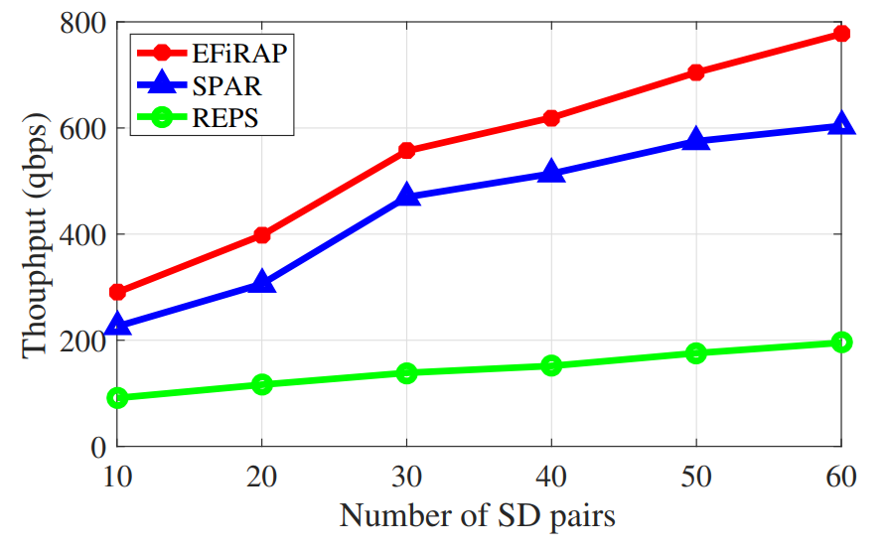
Performance of EFiRAP
Measured in # of E2E connections having a minimum E2E fidelity
EFiRAP significantly outperforms other approaches
  REPS is oblivious to fidelity so performs poorly
  SPAR only establishes/purifies/selects links with a proper link fidelity guarantee

Slide 18
Concluding Remarks
Leading research on CAVs and Quantum Networks
Join us (or refer your fellow students)
Email qiao@buffalo.edu your resume showing your relevant experiences

